Slide 1
Network Layer
Internet Protocol

Slide 2
Layer 3: Network
Defines end-to-end delivery of packets.
Defines logical addressing so that any endpoint can be identified.
Defines how routing works and how routes are learned so that the packets can be delivered.
The network layer also defines how to fragment a packet into smaller packets to accommodate different media.
Routers operate at Layer 3.
Examples :- IP, IPX, AppleTalk.

Slide 3

Links between two hosts

Slide 4

Network layer in an internetwork

Slide 5

Network layer at the source, router, and destination

Slide 6

Network layer at the source, router, and destination (continued)

Slide 7

Note
Communication at the network layer in the Internet is connectionless.

Slide 8
IPv4
The Internet Protocol version 4 (IPv4) is the delivery mechanism used by the TCP/IP protocols.
Datagram
Fragmentation
Checksum
Options

Slide 9

Position of IPv4 in TCP/IP protocol suite

Slide 10

IPv4 datagram format

Slide 11

Service type or differentiated services

Slide 12
Note
The precedence subfield was part of version 4, but never used.

Slide 13

Table 20.1 Types of service

Slide 14

Table 20.2 Default types of service

Slide 15

Table 20.3 Values for codepoints

Slide 16
Note
The total length field defines the total length of the datagram including the header.

Slide 17

Encapsulation of a small datagram in an Ethernet frame

Slide 18

Protocol field and encapsulated data
Stream Control Transmission Protocol
Open Shortest Path First

Slide 19

Protocol values

Slide 20

Maximum transfer unit (MTU)

Slide 21

MTUs for some networks

Slide 22

Flags used in fragmentation

Slide 23

Fragmentation example

Slide 24
IPv6
The network layer protocol in the TCP/IP protocol suite is currently IPv4.
Although IPv4 is well designed, data communication has evolved since the inception of IPv4 in the 1970s.
IPv4 has some deficiencies that make it unsuitable for the fast-growing Internet.
Advantages
Packet Format
Extension Headers

Slide 25
Advantages of IPv6 over IPv4
Larger address space
  IPv4 – 128 bits , IPv4 – 32 bits
Better header format
New options
Allowance for extension
Support for resource allocation
  TOS is removed – and jlow label for audio & vedio
Support for more security
Support for mobility

Slide 26
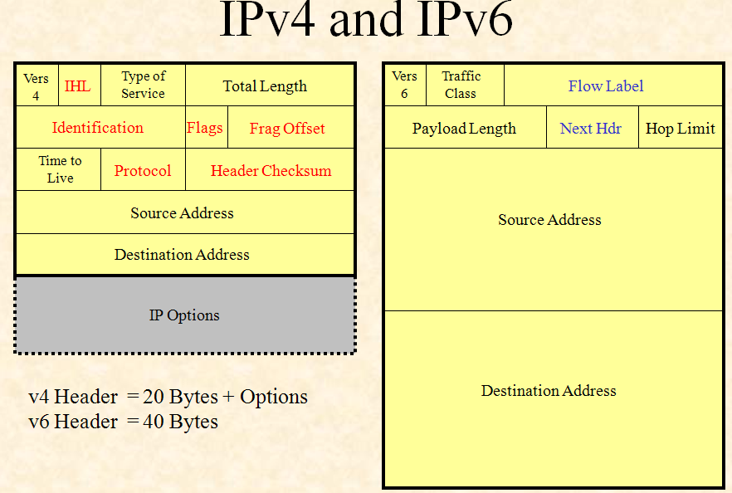

Slide 27

IPv6 datagram header and payload

Slide 28

Format of an IPv6 datagram

Slide 29

Next header codes for IPv6

Slide 30

Priorities for congestion-controlled traffic

Slide 31

Priorities for noncongestion-controlled traffic

Slide 32

Comparison between IPv4 and IPv6 packet headers

Slide 33

Extension header types

Slide 34
Comparison between IPv4 options and IPv6 extension headers

Slide 35
TRANSITION FROM IPv4 TO IPv6
Because of the huge number of systems on the Internet, the transition from IPv4 to IPv6 cannot happen suddenly.
It takes a considerable amount of time before every system in the Internet can move from IPv4 to IPv6.
The transition must be smooth to prevent any problems between IPv4 and IPv6 systems.

Slide 36

Three transition strategies

Slide 37

Dual stack

Slide 38

Tunneling strategy

Slide 39

Header translation strategy

Slide 40
Header translation

